Slide 1
Without modern medical intervention, how many times would you have died by now?

Slide 2
Communicating Research with Effective Storytelling
AFS2024 Workshop - Day 2
Megumi Oshima & Pavel Dimens

Slide 3
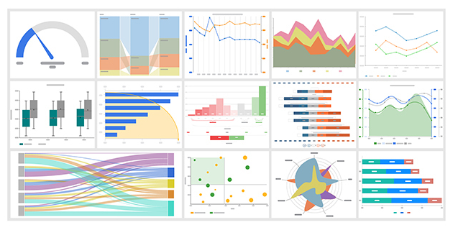
Information
facts
facts, but pictures

Slide 4
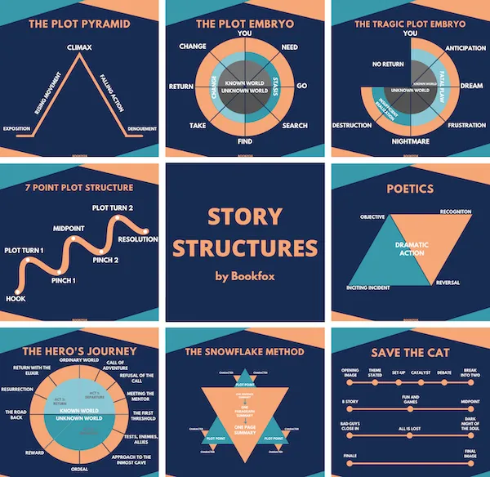
Story
introduction
setting
characters
direction
conflict to resolve

Slide 5
Story about information
introduction
setting
characters
direction
conflict to resolve
where are we
what are we doing
what are we looking at
It’s just worldbuilding ground us

Slide 6
Story
introduction
setting
characters
direction
conflict to resolve
why are you bothering
why should we care
convince us this is cool or important

Slide 7
Story
introduction
setting
characters
direction
conflict to resolve
we need to go somewhere

Slide 8
Direction

Slide 9
Direction
The setup
The rationale
What you did
How it went
Ok cool, what now?
linear flow

Slide 10

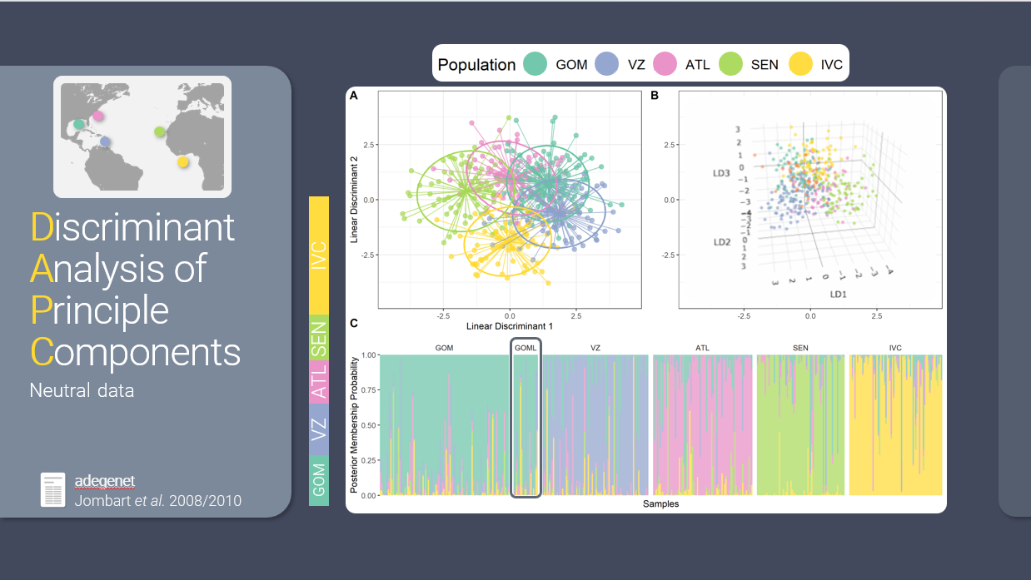
flow
visual
auditory

Slide 11
Exercise

Slide 12

floooooooooow
sound is a stream
sight is a shotgun

Slide 13
5 Minute Break

Slide 14

✨Aesthetics ✨
Keep an audience’s interest for technical topics
A chance to add some personality
Notes:
Less text
Slide Master
Insert Icons

Slide 15
Fonts
sans serif vs serif
Size
Mix n’ match for emphasis
Google Fonts
Notes:
Choose a sans serif font option over a serif
Make sure the font size (on everything) is large enough for an audience to read in a large room
Can have a main font and then use a different one for emphasis or accent
Resources like google fonts have a lot of different fonts you can download and use for free

Slide 16
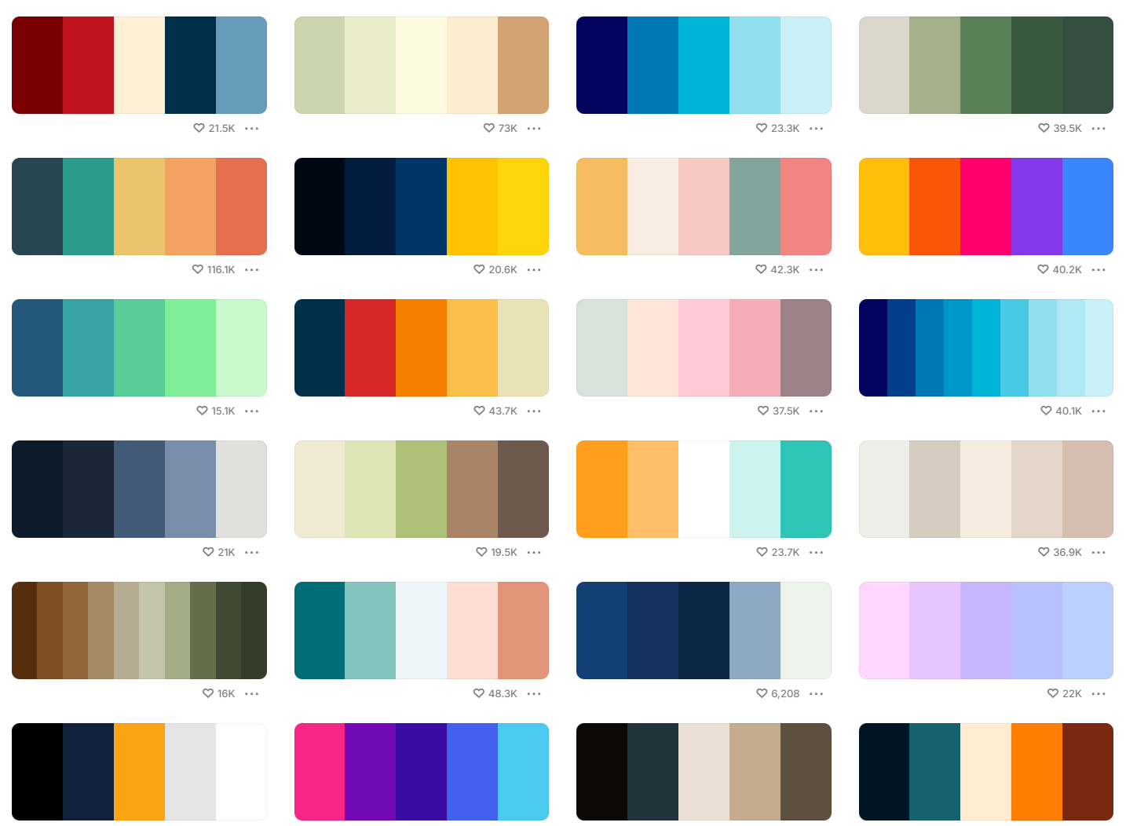
Colors
Consistent
Cohesive
Beyond the defaults
coolors
Notes:
Creating a color palette to use throughout your talk can give it a really nice cohesive feel. Powerpoint’s defaults have improved over time but to really make your presentation stand out, create your own. You want to make sure your color palette is pleasing (not all bright vivid colors that are harsh on the eyes and hard to see) and accessible. You can get inspiration from anything, just a quick google for color palette or use resources like coolors to find pre-made palettes or create your own.

Slide 17
Less text
Use a consistent color palette throughout the presentation, and match those colors in figures and graphs.
Create cohesive color palettes that look good and are accessible.
Look for inspiration online or at pre-made palettes.

Slide 18
Less text
Use a consistent color palette throughout the presentation, and match those colors in figures and graphs.
Create cohesive color palettes that look good and are accessible.
Look for inspiration online or at pre-made palettes.

Slide 19
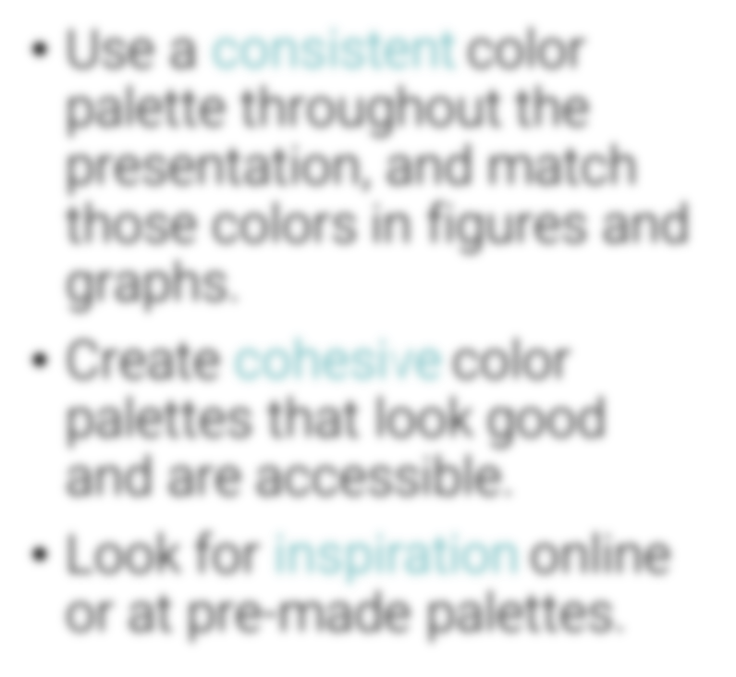
Less text
Consistent
Cohesive
Beyond the defaults

Slide 20
Use icons

Slide 21
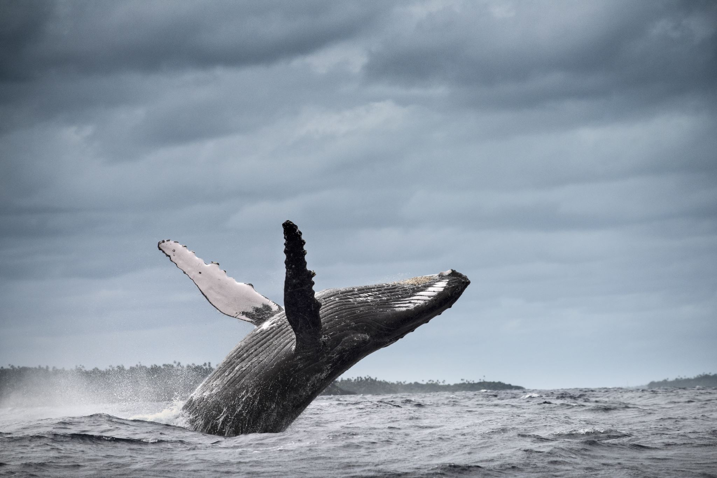
Make your images dimensional

Slide 22
Make your images dimensional
Rounded corners

Slide 23
Make your images dimensional
Rounded corners
Add a drop shadow

Slide 24
Make your images dimensional
Rounded corners
Add a drop shadow
Give it a background

Slide 25
Make your images dimensional
Rounded corners
Add a drop shadow
Give it a background
Change the shape

Slide 26
5 Minute Break

Slide 27
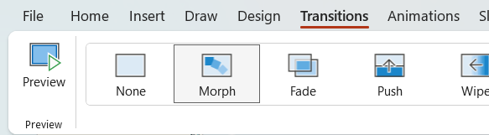
Behold: Morph

Slide 28
Topic Title

Slide 29
Topic Title

Slide 30
Second Topic

Slide 31
Third Topic

Slide 32
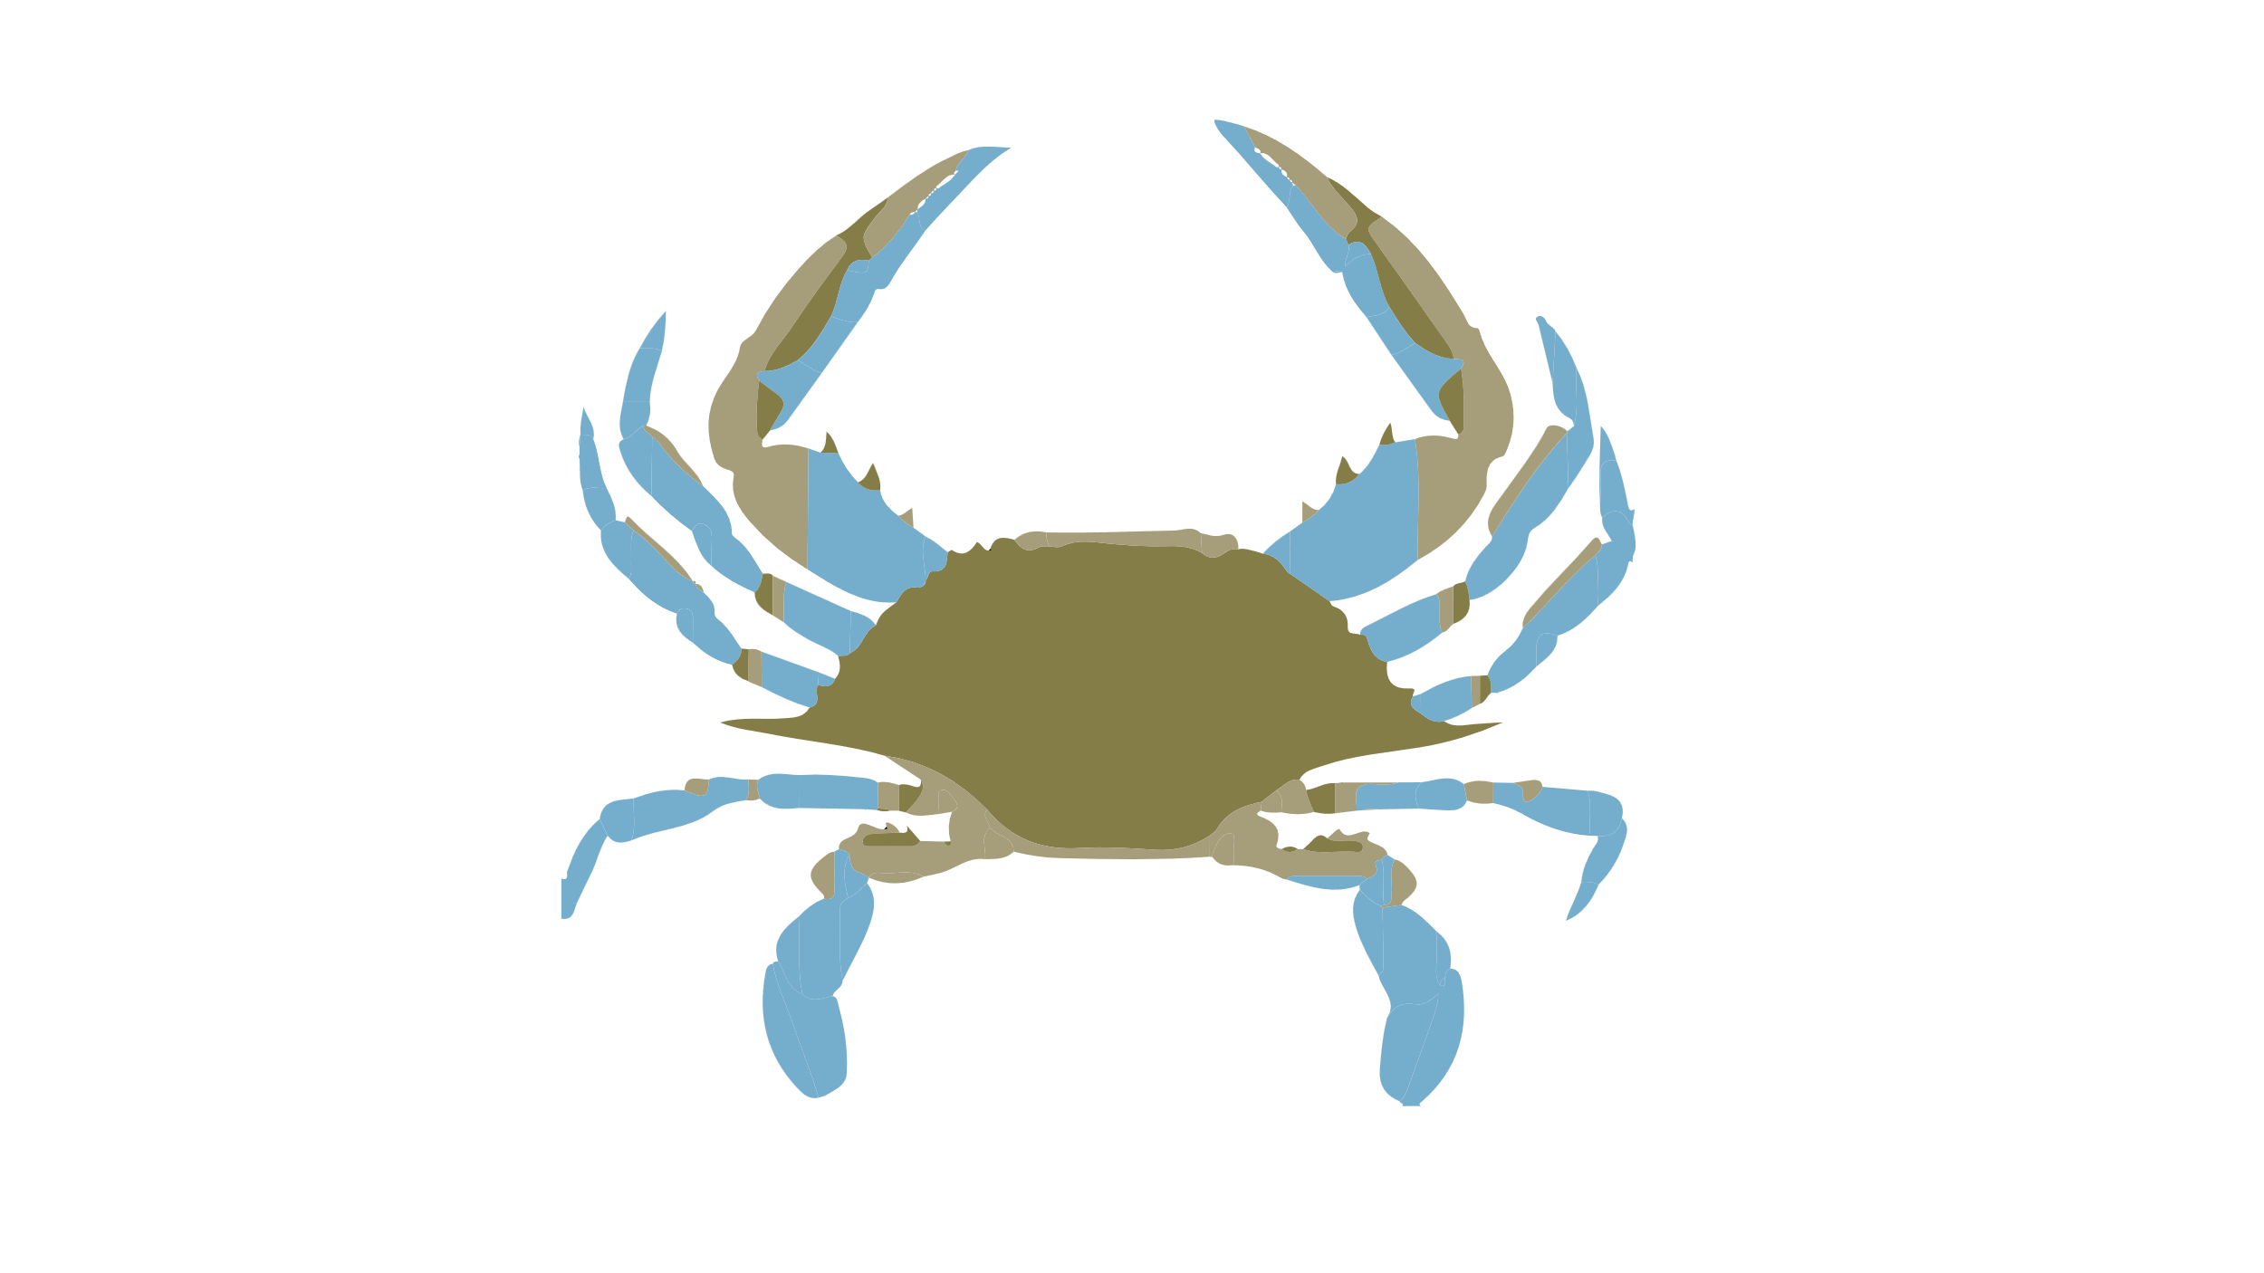
Here are facts
Is this big
Likes to do this
Likes to go here
Hates paprika
Nihilistic
Cyberbully

Slide 33
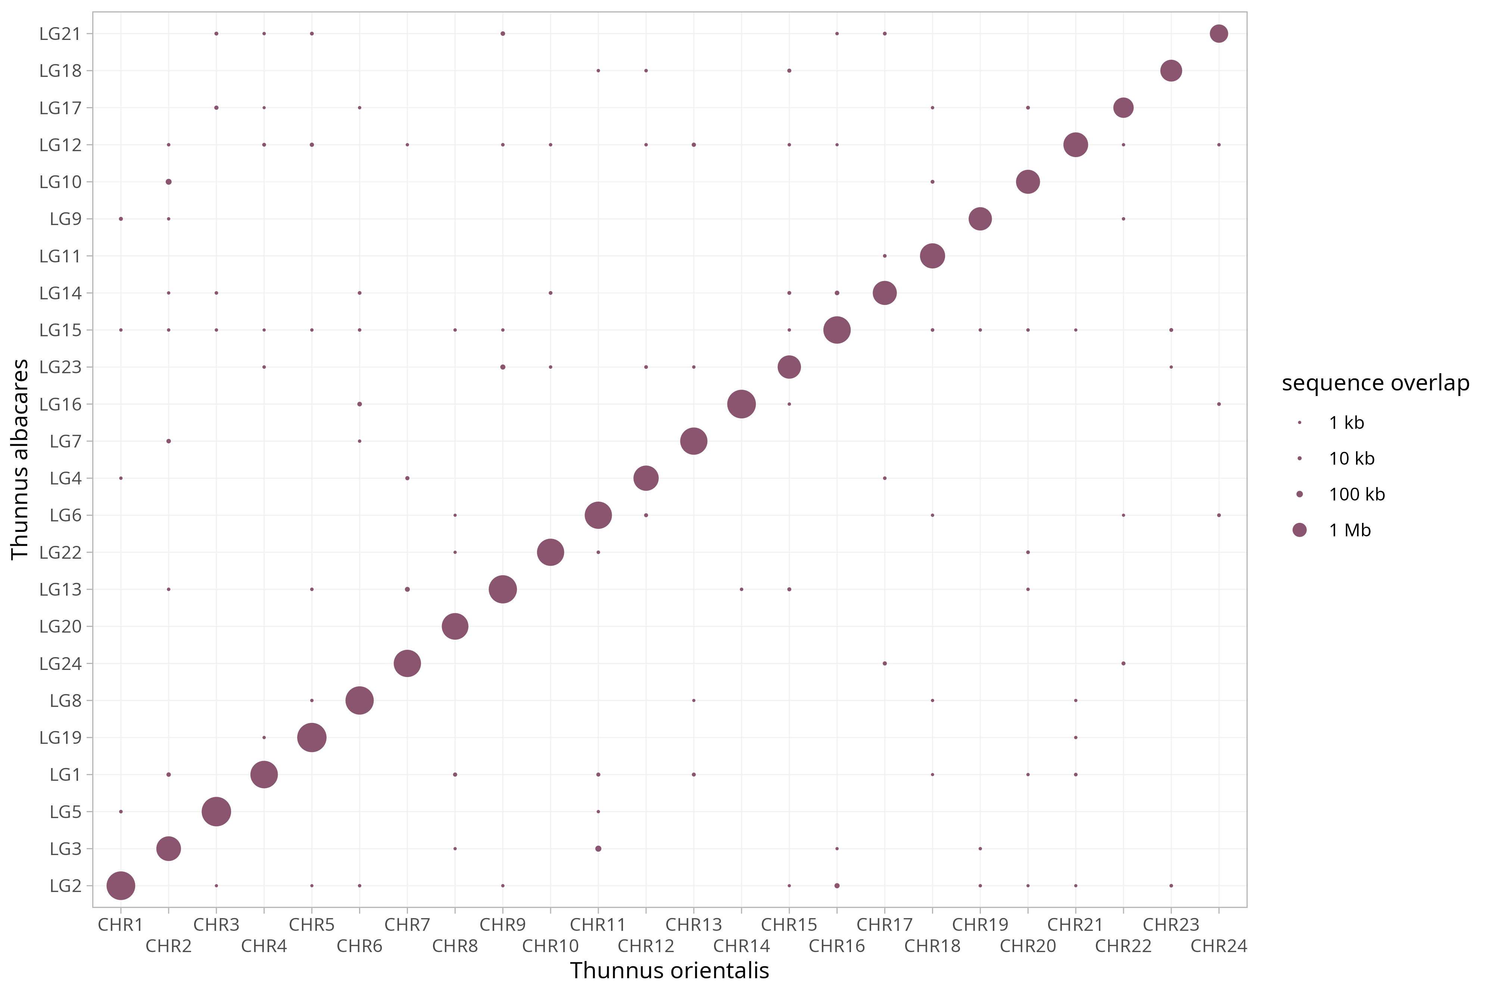
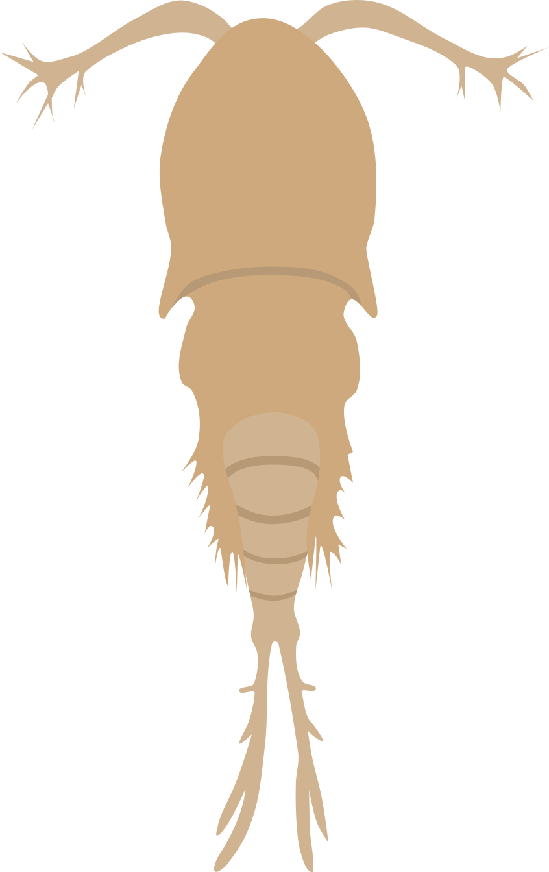
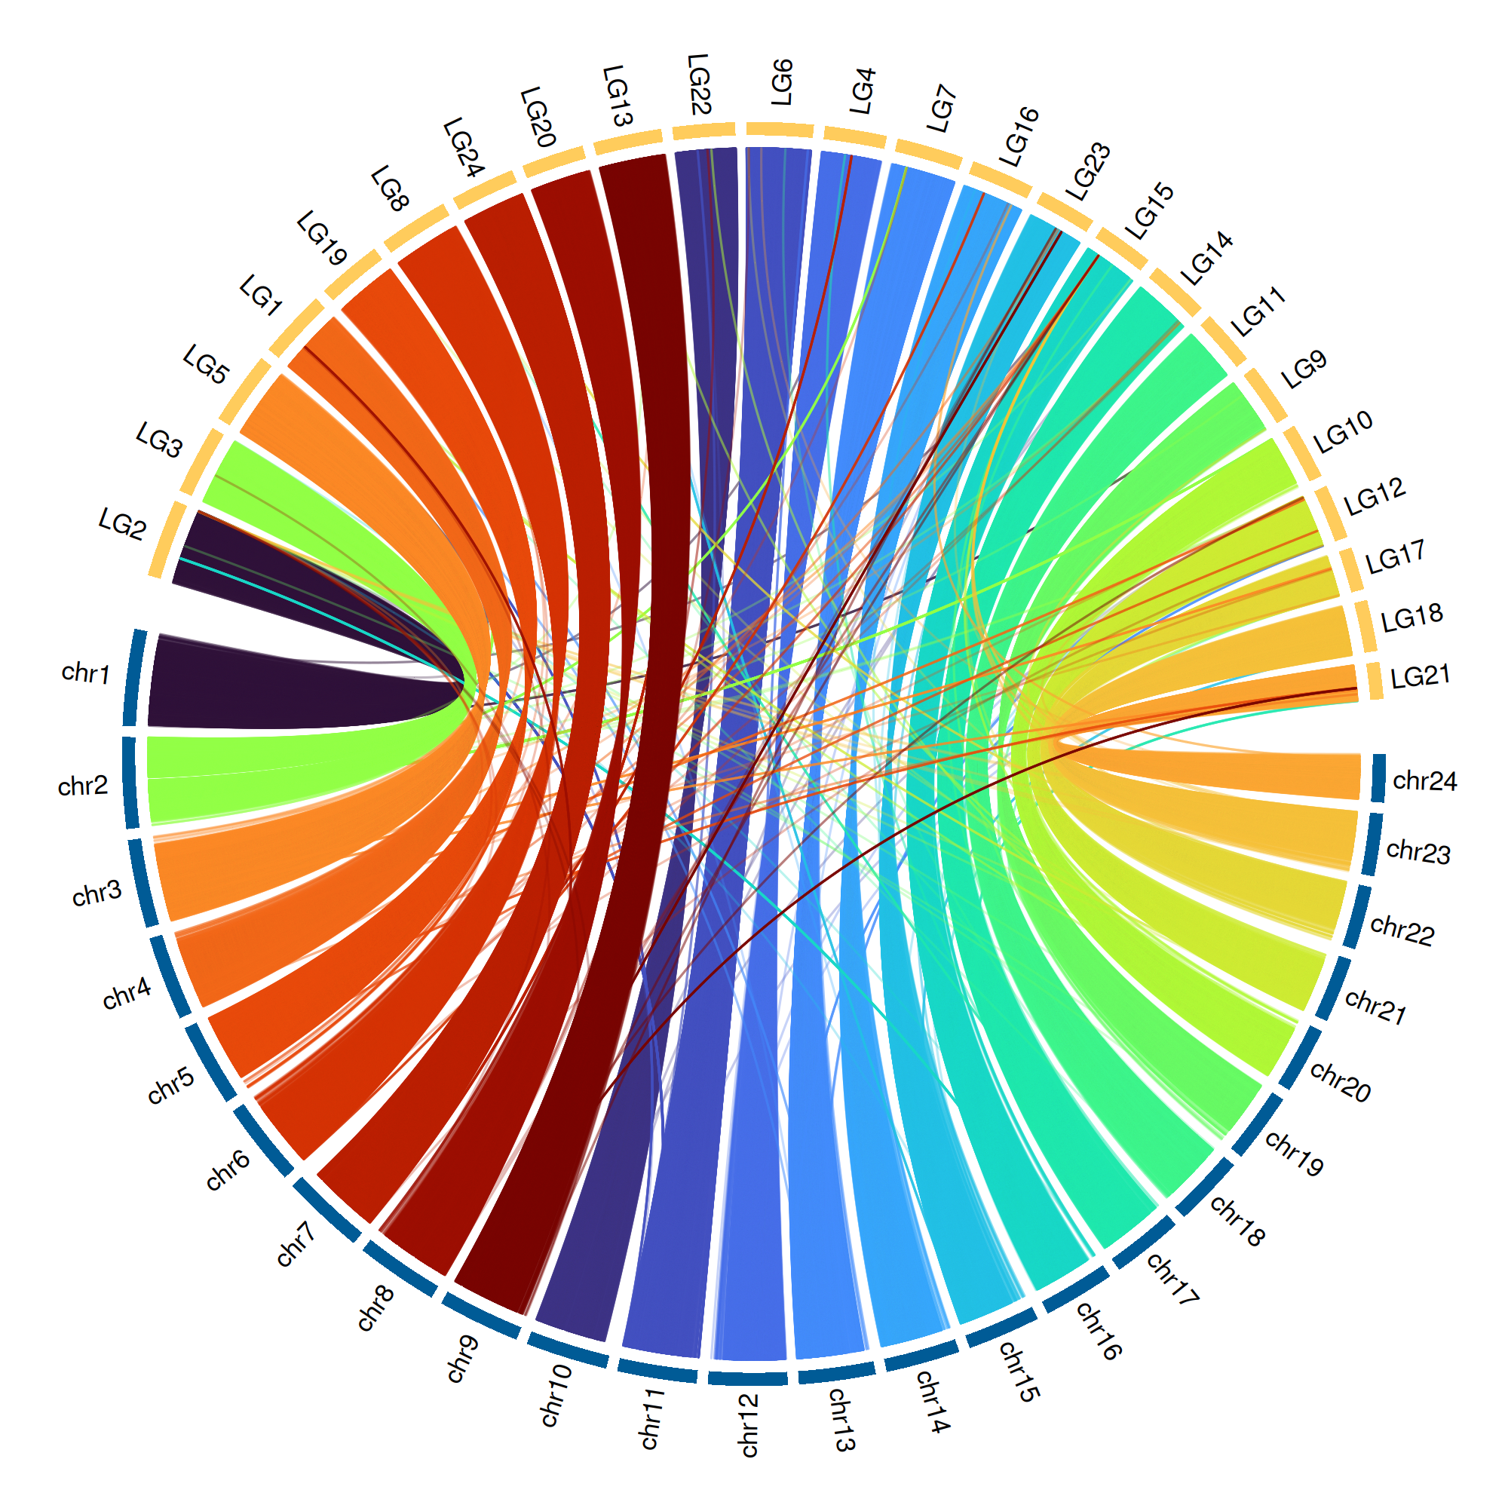
Is this big
Likes to do this
Likes to go here
Hates paprika
Nihilistic
Cyberbully

Slide 35

Appear

Slide 36
Appear

Slide 37

Appear

Slide 38
Appear

Slide 39

Push

Slide 40
Push

Slide 41
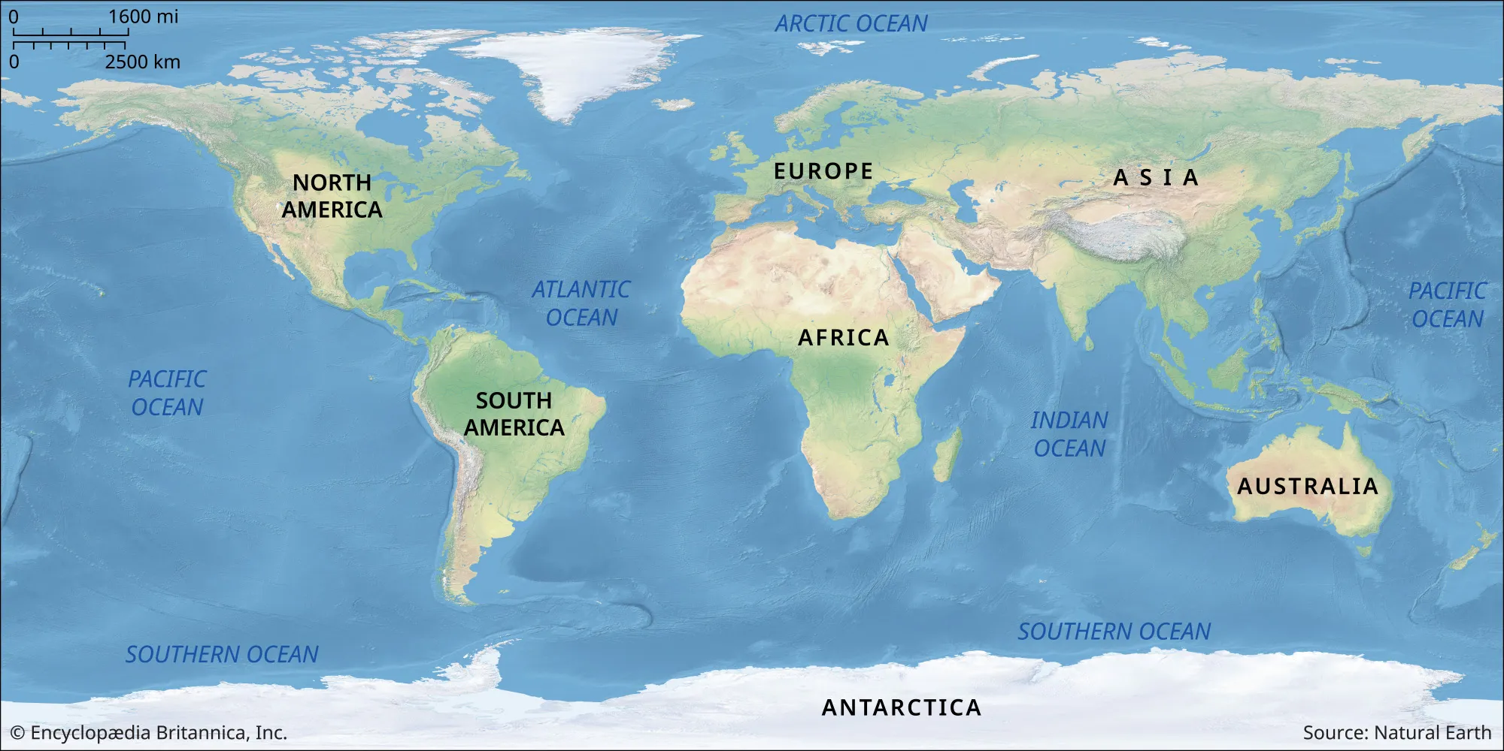
Image Pan

Slide 42
Image Pan

Slide 43
Image Pan

Slide 44
Image Pan

Slide 45
5 Minute Break

Slide 46
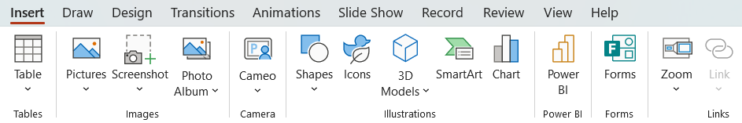
Zoom

Slide 47
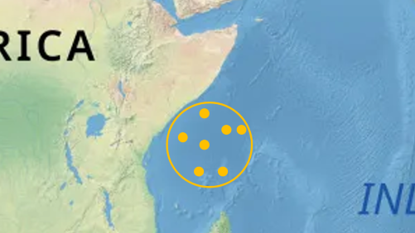
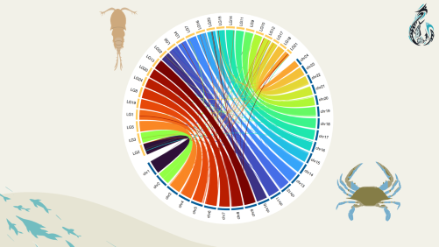
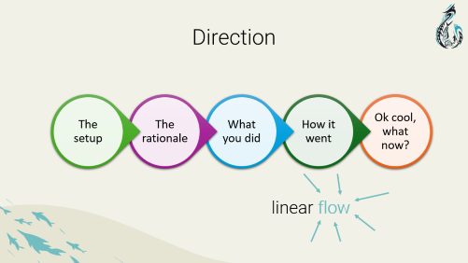



Zoom

Slide 48
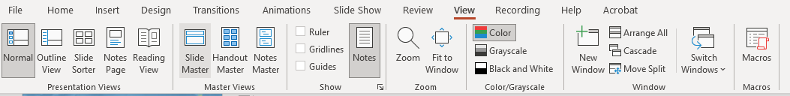
Slide Master

Slide 49
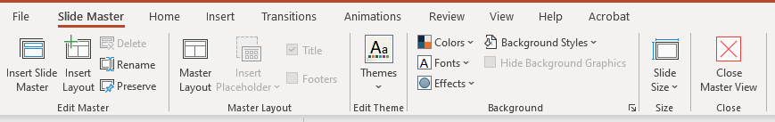
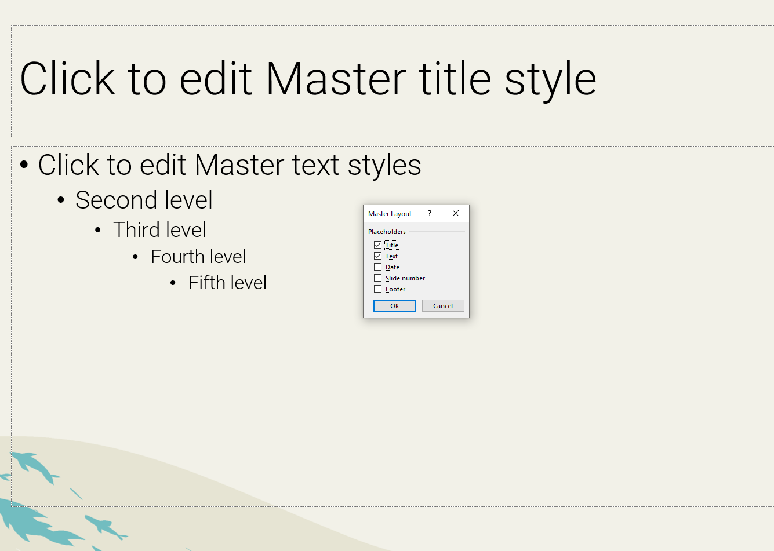

Slide 50
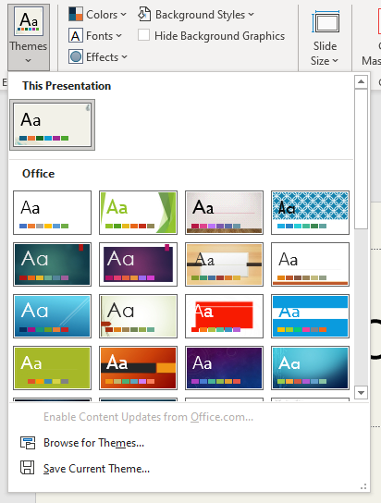
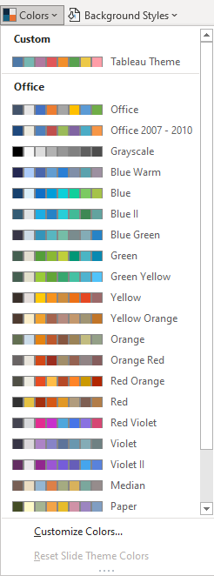
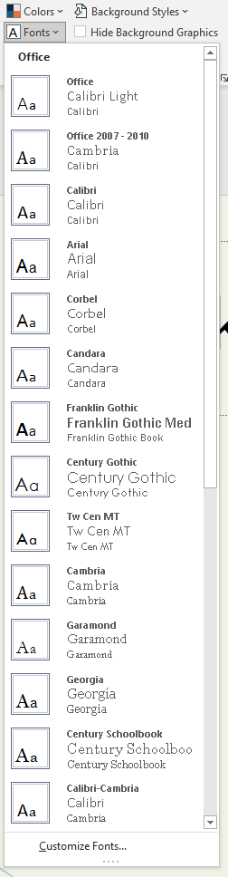

Slide 51
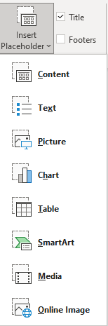
Title
Chart
Text

Slide 52
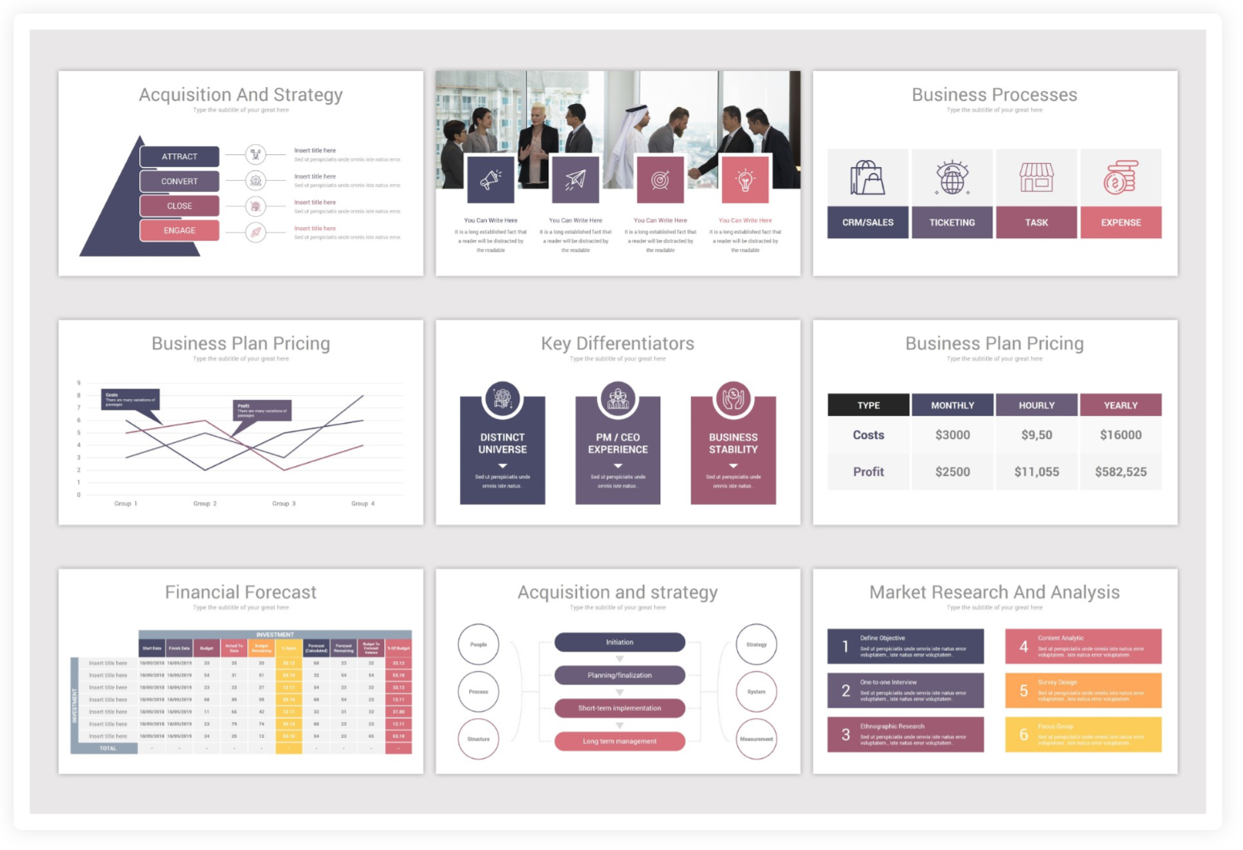
Think outside the classic layout

Slide 53
Important things are important

Slide 54
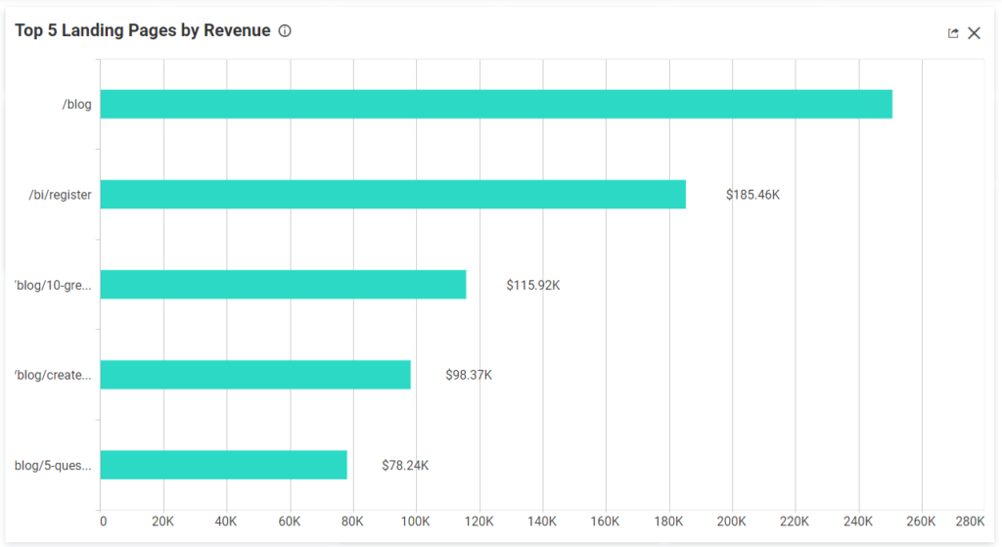
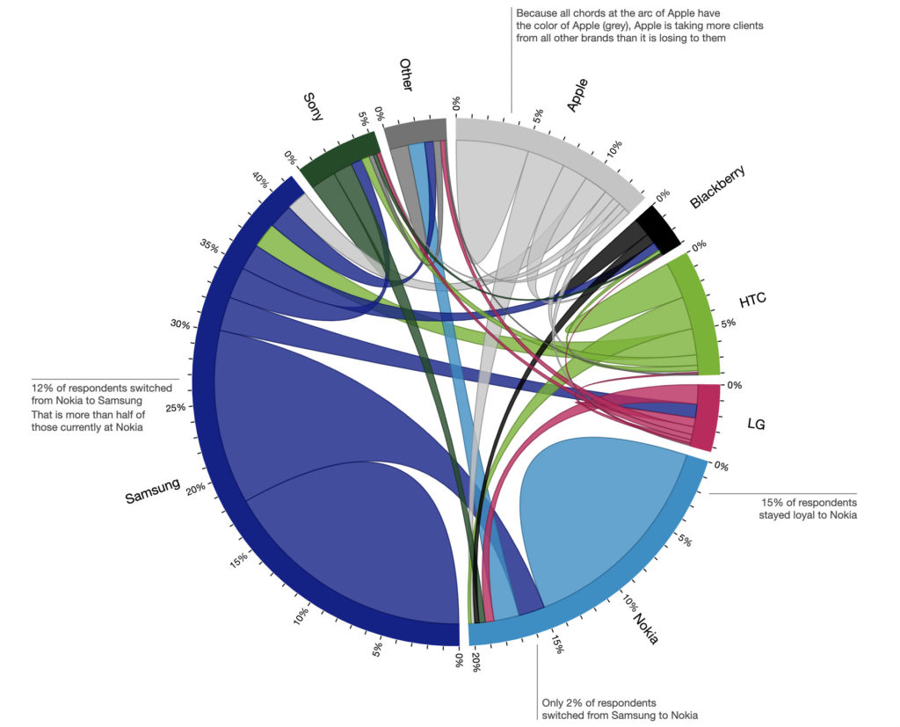
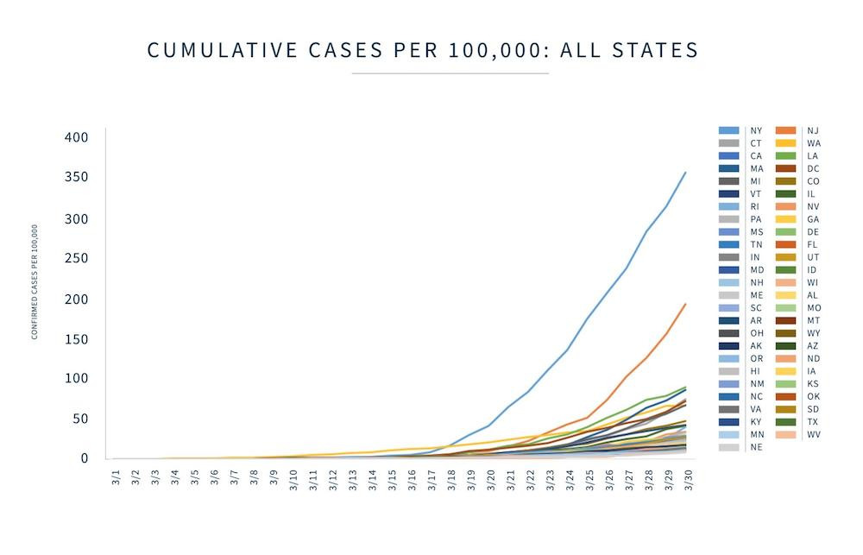
Title
some kind of text
more text about stuff

Slide 55
Title

Slide 56
Title

Slide 57
Title

Slide 58
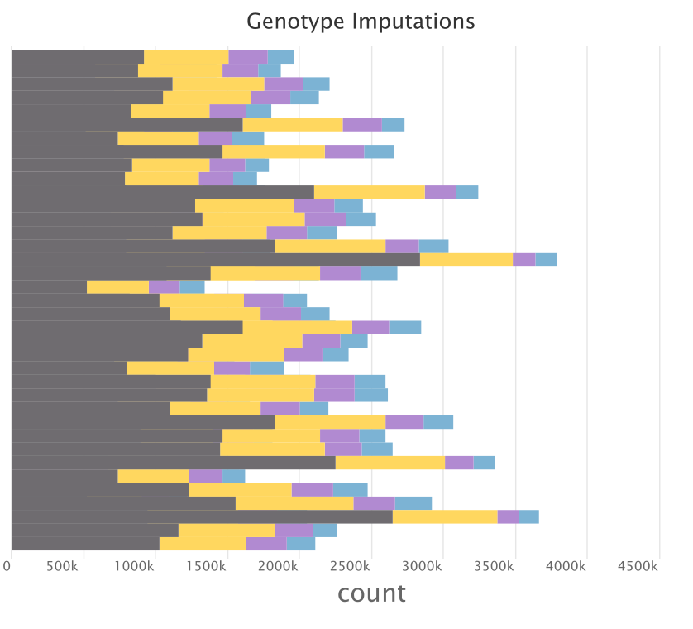
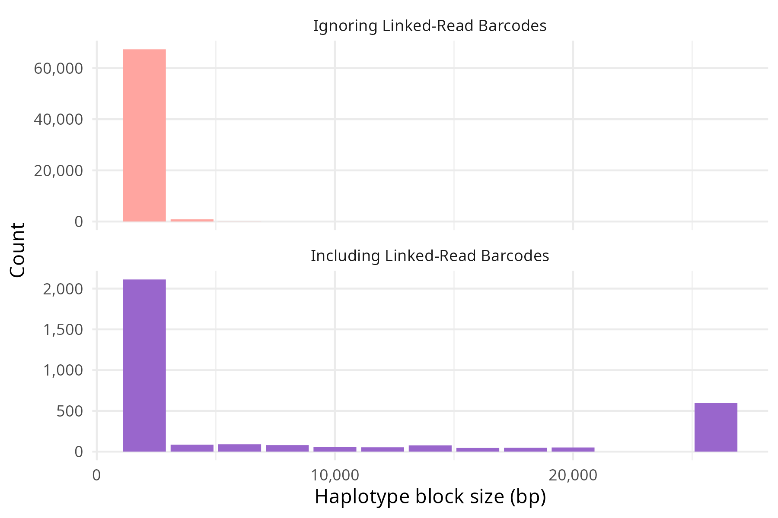
Recover many missing genotypes with linked-read aware imputation
Not Imputed
Hom Ref
Hom Alt
Het
called genotype
Phase SNPs into haplotypes
25kbp+

Slide 59

Recover many missing genotypes with linked-read aware imputation
Phase SNPs into haplotypes
25kbp+
Not Imputed
Hom Ref
Hom Alt
Het
called genotype

Slide 60
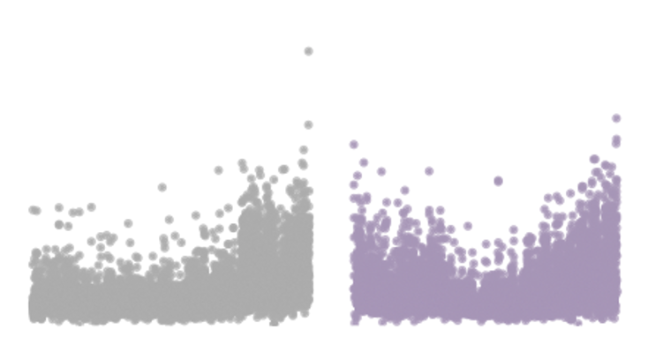


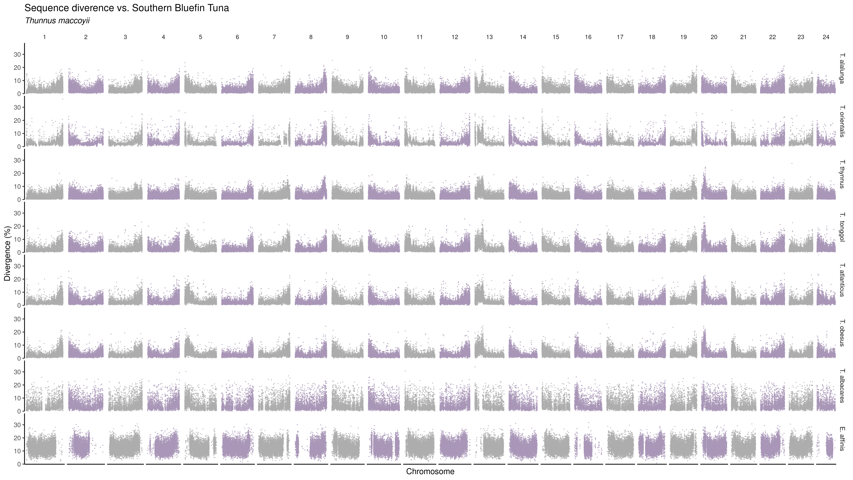








Sequence divergence vs Southern bluefin tuna
Marçaiset al. 2018
Notes:
relationship btwn species
conserved regions
confirm a tree

Slide 61
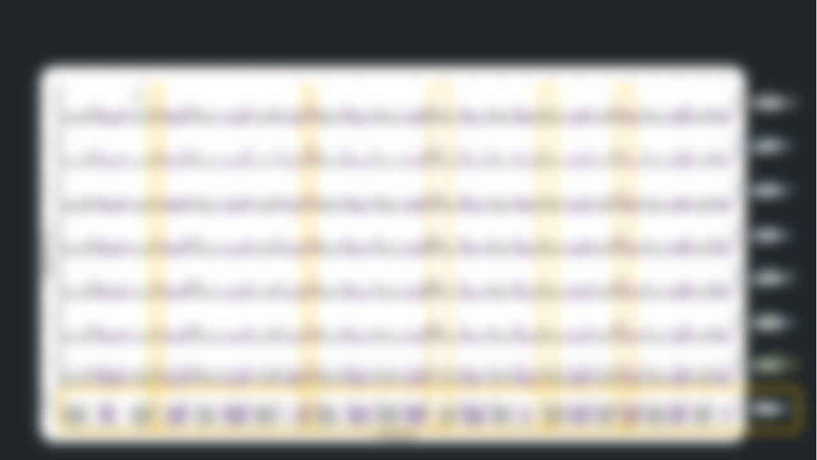
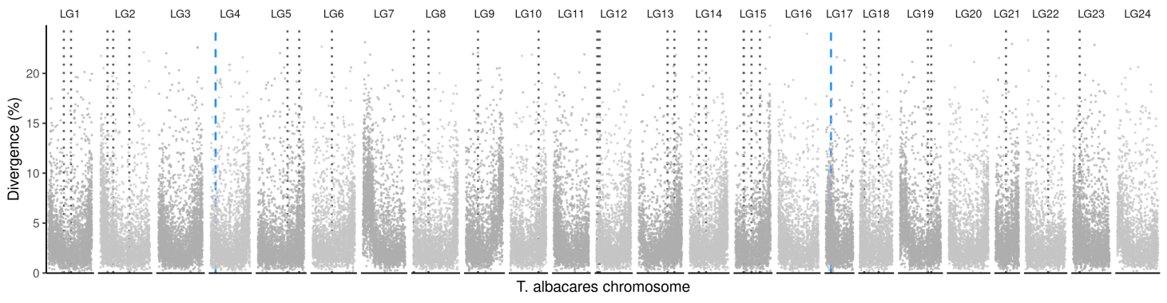




Sequence divergence vs Southern bluefin tuna
Sequence divergence between Yellowfin and Blackfin tuna
Marçaiset al. 2018
Yellowfin tuna
Blackfin tuna
Notes:
relationship btwn species
conserved regions
confirm a tree

Slide 62

Sequence divergence vs Southern bluefin tuna
Sequence divergence between Yellowfin and Blackfin tuna
Marçaiset al. 2018
Centromere?
Telomere?
Notes:
relationship btwn species
conserved regions
confirm a tree

Slide 63
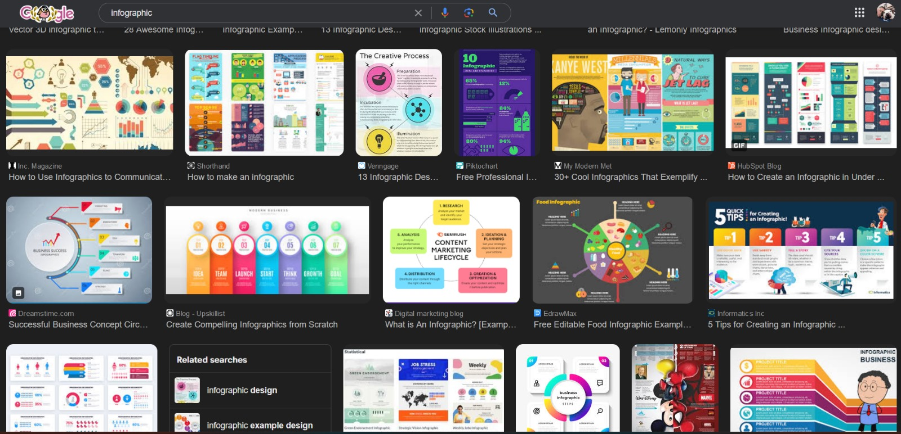
Look at what the pros are doing

Slide 64
5 Minute Break

Slide 65



Group Project
Fix these terrible presentations

